Slide 1
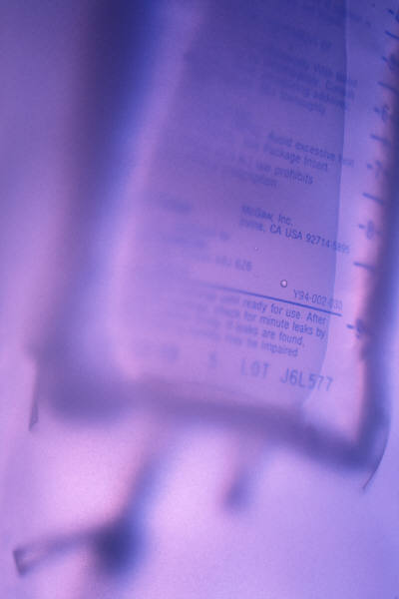
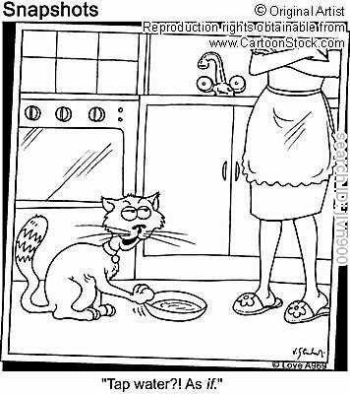
Fluid Administration/Nursing Care
a) VTDRG Chapter 8,
pgs. 359-367
b) CTVT, pages 789-793
Please bring your VTDRG book
to class for this section.

Slide 2
Normal Fluid Balance
The body is made up of approximately 60% water.
This is divided into intracellular (2/3 of body fluid) and extracellular fluids (1/3 of body fluid)
  Intracellular fluids are located within cells
  Extracellular fluids are classified as either Intravascular (within the vessels) and interstitial (in tissue spaces between blood vessels and cells).
The body maintains fluid balance on a constant basis – homeostasis.
Fluids are gained via:
  Oral intake
  Metabolism in the body

Slide 3
Indications for Fluid Administration
Dehydration
Shock
Loss of blood
Sx (surgical) procedure
  Potential of fluid loss or excessive blood loss
  Maintenance of blood pressure and perfusion
Disease that depletes the normal fluid, electrolyte or acid-base balances
  (polyuria, decreased oral intake of fluids)

Slide 4
Contraindications for Fluid Therapy
Conditions that carry a risk of pulmonary edema from fluid shifting into the lungs necessitate the need for caution and frequent monitoring.
  Pulmonary contusions
  Existing pulmonary edema
  Brain injury
  Congestive heart failure
Overhydration
Adjust rates according to patient response to fluid therapy and veterinarian orders.

Slide 5
Fluid Treatment Questions
How much fluid will be needed to rehydrate the patient, right now?
How much fluid will be needed to maintain the animals requirements?
How much fluid will be needed to compensate for ongoing losses?

Slide 6
Fluid Losses
Daily Maintenance Requirements
Ongoing Problems
Sensible losses (measurable losses)
  Urine output
B. Insensible losses (inevitable losses)
  Feces
  Respiration
  Cutaneous losses
A. Contemporary losses
  Vomiting
  Diarrhea

Slide 7
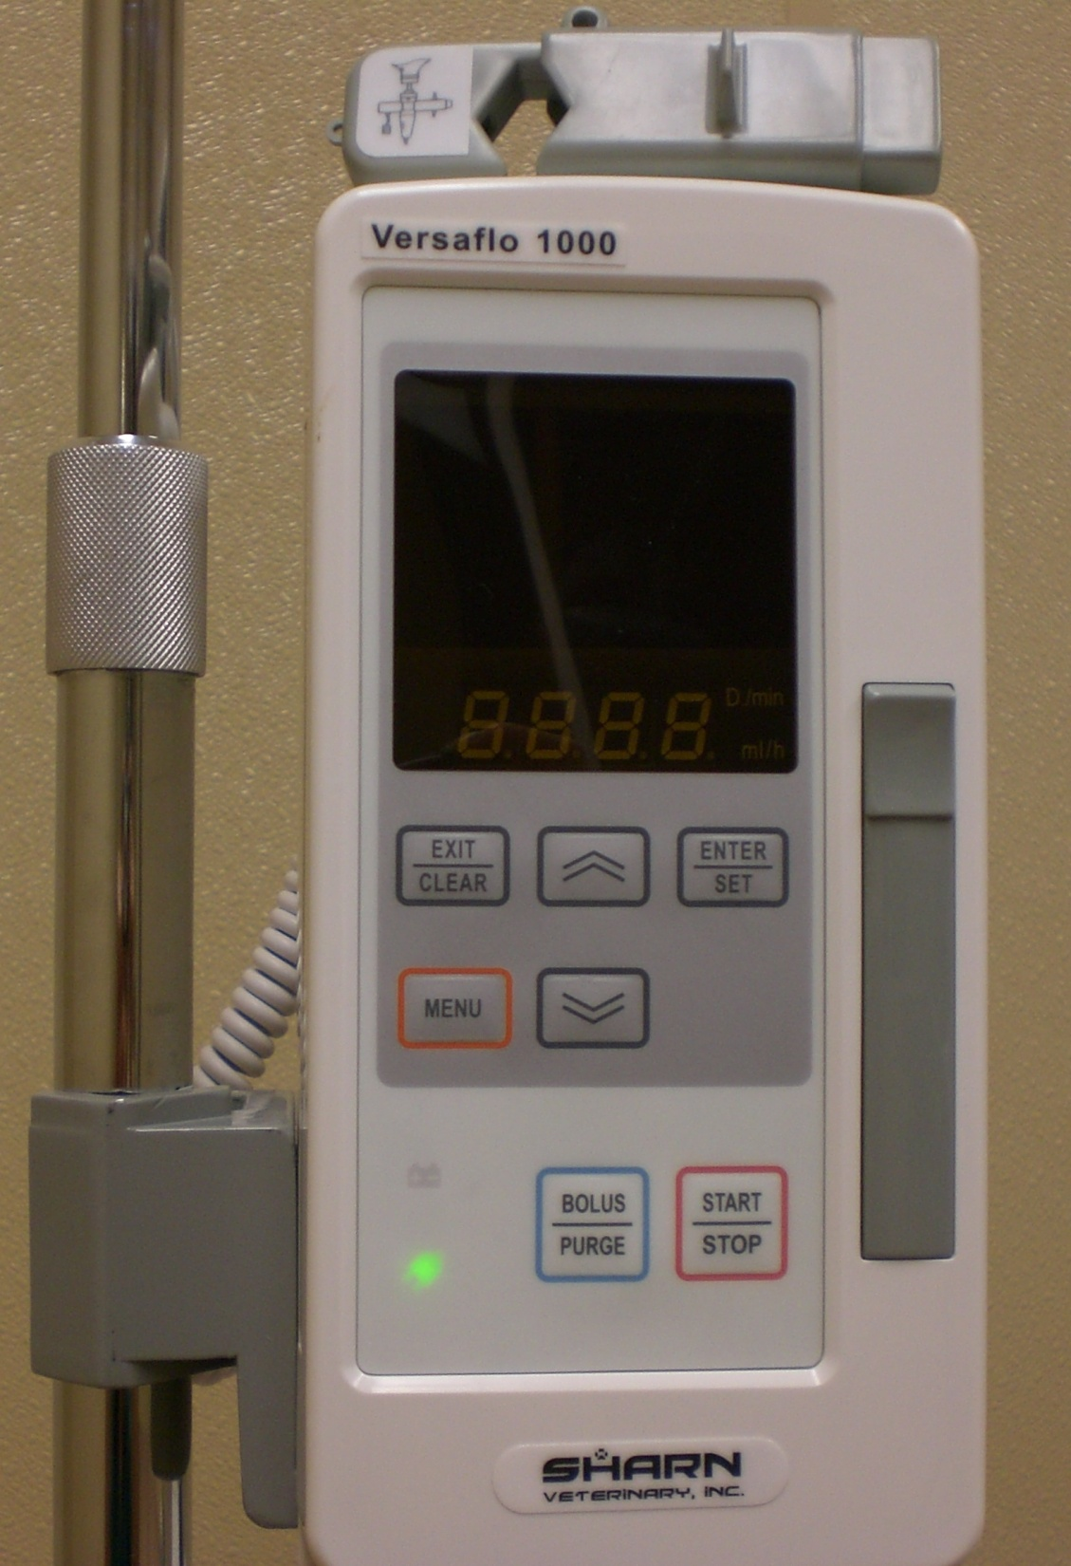
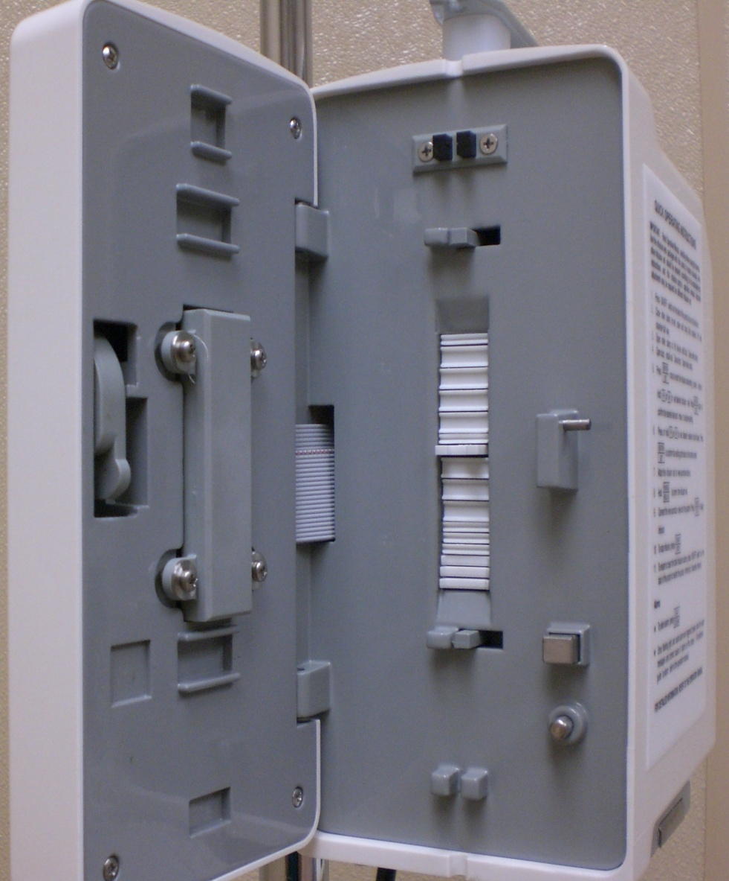
INSIDE OF THE IV PUMP

Slide 8
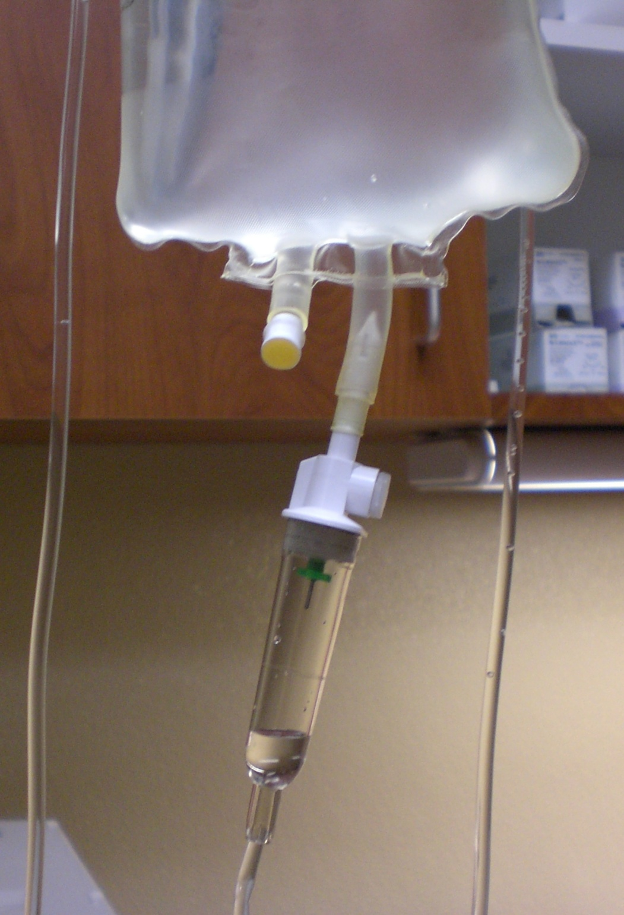
IV BAG OF FLUIDS
IV LINE ATTACHES HERE
AIR VENT CAP
YOU CAN ACTUALLY SEE THE DROPS WHEN MANUALLY CALCULATING FLUID RATES HERE.
DRIP CHAMBER

Slide 9
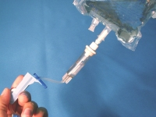
THE ROLLER CLAMP
ROLLING IT UPWARDS INCREASES THE FLUID RATE WHILE ROLLING IT DOWNWARDS DECREASES THE FLUID RATE.
ROLLING THE WHEEL ALL THE WAY DOWN SHUTS OFF FLUIDS TO THE PATIENT.

Slide 10
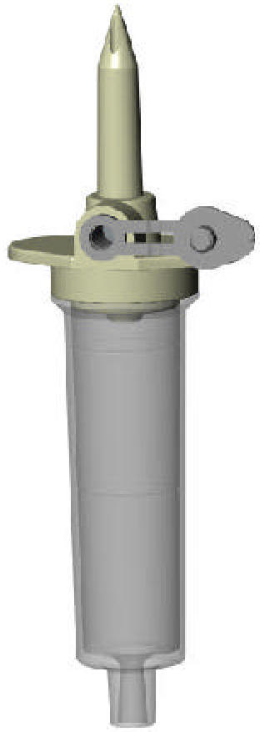
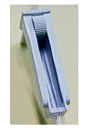

BE CAREFUL AS THE SPIKE IS VERY SHARP AND CAN CUT THROUGH THE IV LINE/BAG AS WELL AS CUT YOU.
AIR VENT CAP
Injection port aka injection Y-site
ROLLER CLAMP

Slide 11
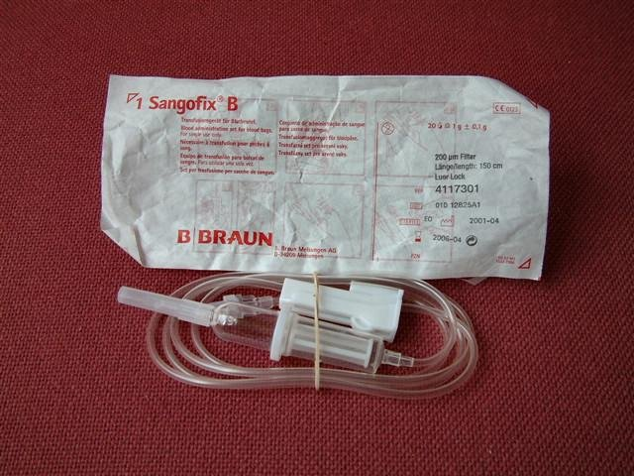
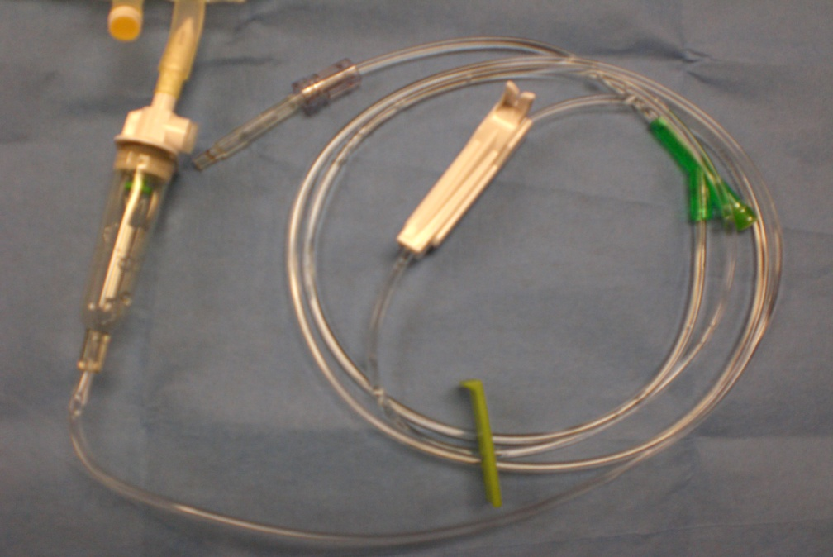
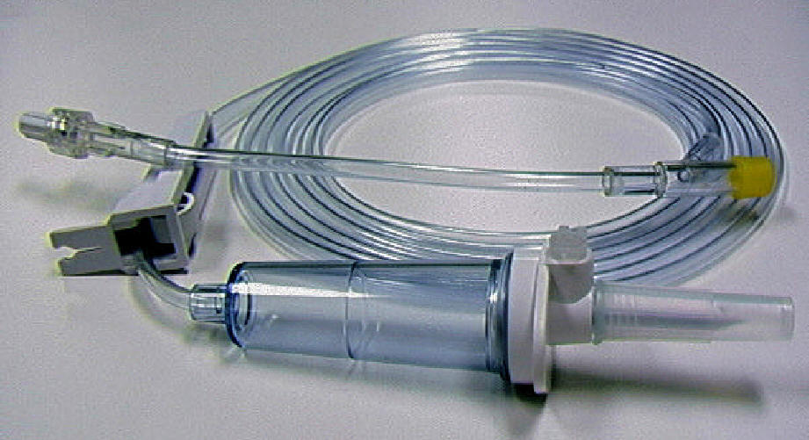
Primary IV drip sets come in many different shapes, colors and sizes

Slide 12
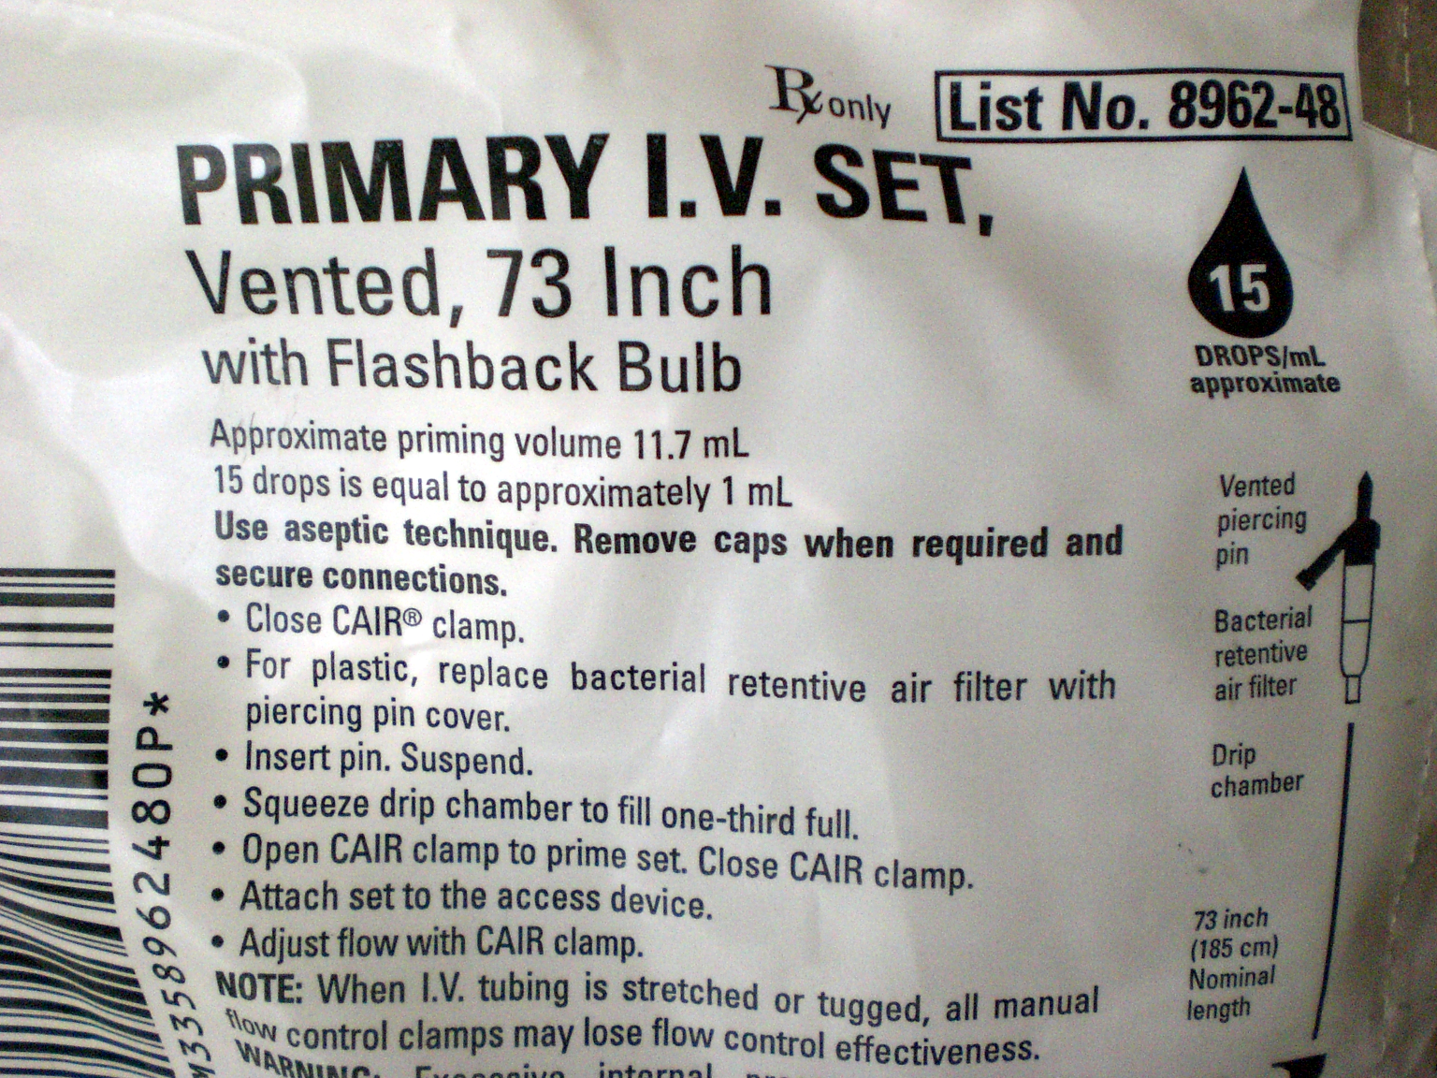
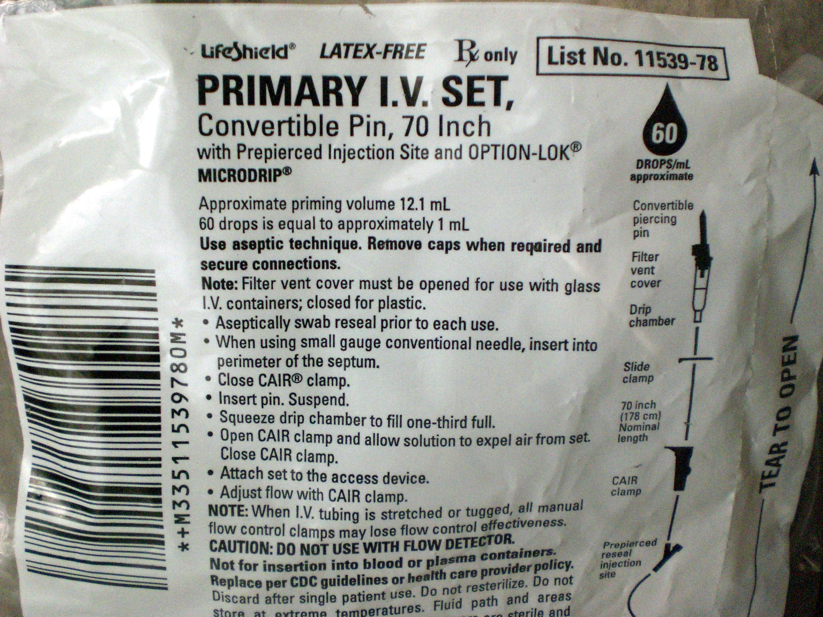
Drip sets:
Macro (10, 15, 20)
Micro (60)

Slide 13
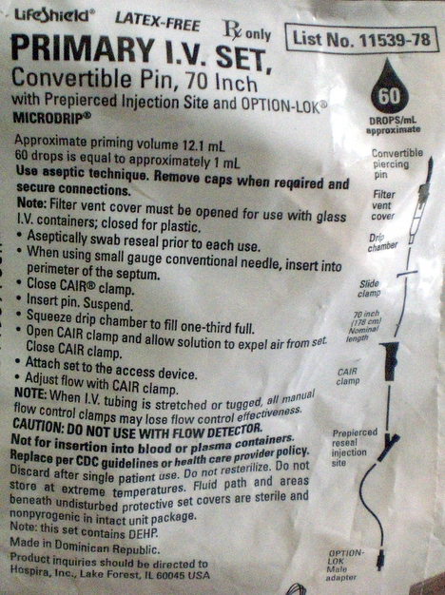

Slide 14
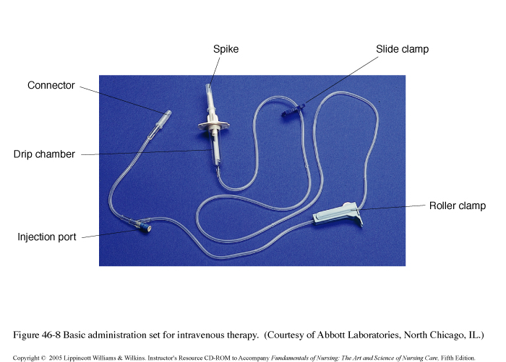
Primary IV set for intravenous therapy.
The catheter and fluid drip set must be kept sterile and free
of blood clots to allow long-term use (3 to 5 days maximum).
Heparinized saline or sterile saline is used to flush the line.

Slide 15
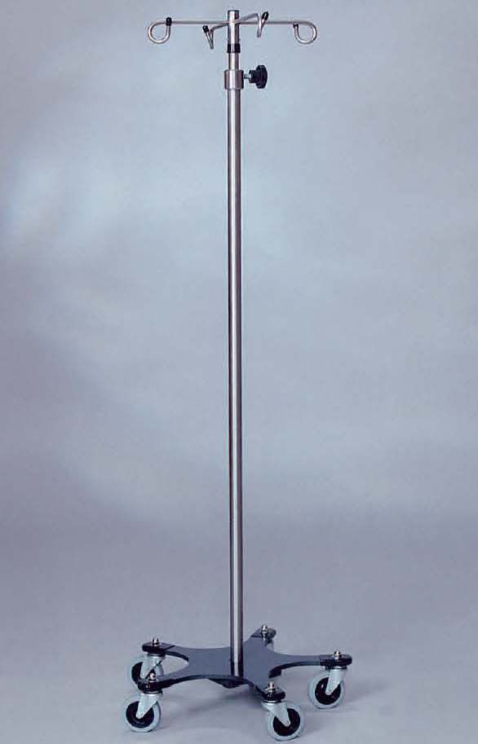
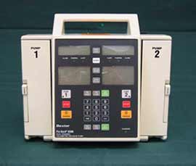
IV PUMPS COME IN MANY VARIETIES
IV Pump/Fluid Stand
BAXTER 6300 DOUBLE PUMP

Slide 16
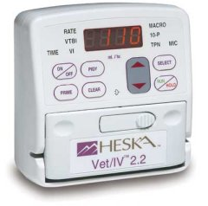
HESKA VET IV INFUSION PUMP

Slide 17
Physical Signs of Dehydration
Decreased skin turgor
Moistness of mucous membranes (MM). Are they moist, tacky or dry?
Decreased capillary refill time (CRT) Normal=1-2 secs
Rapid heart rate (HR)
Eyes sunken into bony orbits

Slide 18
What is the Skin Turgor test?
Assess the amount of time it takes for the skin to return to the animal’s body after gently pulling up into a “tent” along the back of the neck and along the spine.
This test is not accurate in older animals or animals that have recently lost weight

Slide 19
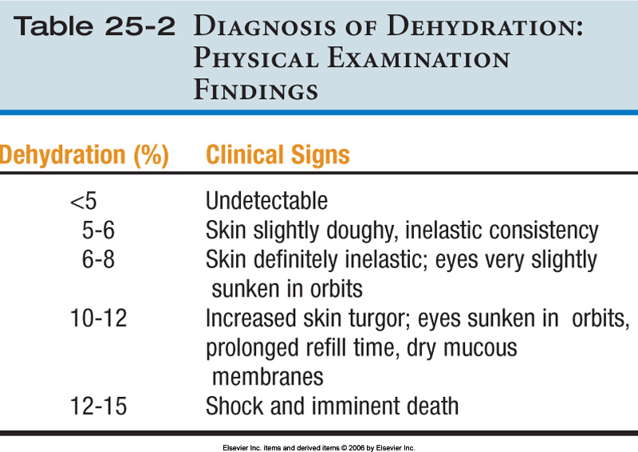
Pg. 790-CTVT
= Seeing with your eyes

Slide 20
Laboratory Dehydration Tests
Packed Cell Volume (PCV)
Total Plasma Protein Concentration (TP)
  PCV and TP will be elevated except in cases of severe hemorrhaging (they will be decreased)
Increased urine specific gravity (SG/UG)
Serial body weights (1 lb of body weight is equivalent to 1 pt or 480 ml of fluid)
Electrolyte assessment
  Only reflects dehydration if the kidneys are healthy
Note: Laboratory testing assists in detecting relative changes but does not reflect the absolute hydration status of the patient.

Slide 21
Other indicators of dehydration
Decreased urine output
  Normal production is 1 to 2 mL/kg/hr
Constipation
Cold extremities
Signs of shock including a rapid thready pulse, tachycardia, and tachypnea

Slide 22
Laboratory Assessment Values
*PCV Dog: 37-55%
*TP Dog: 5.4-7.6 g/dL
SG/UG Dog: > 1.035
*PCV Cat: 24-45%
*TP Cat: 6.0-8.1 g/dL
SG/UG Cat: > 1.040
↑ PCV=dehydration
↑ TP=dehydration
*THESE VALUES ARE ON PAGE 367 IN THE VETERINARY TECHNICIAN’S DAILY REFERENCE GUIDE

Slide 23
VTDRG pg. 362
Routes of Fluid Administration
Oral (Minimal loss) Easy, cheap and safe.
Subcutaneous (Mild-Moderate dehydration) Never use >2.5% dextrose, as this will cause sloughing of the skin and abscesses.
Intravenous (Severe dehydration; perioperative precaution) via IV catheter.
Intraperitoneal (mild to moderately dehydrated; large volumes) This method is not commonly used and can be very dangerous if you accidentally hit an organ.

Slide 24
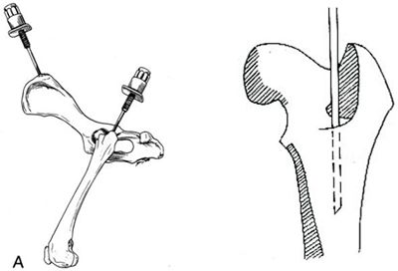
Intraosseous (head of the femur or humerus of small animals, neonates or animals with poor venous access) via 16 gauge bone marrow needle and other materials. IO infusion provides a direct conduit to the blood stream through the bone. This technique must be sterile!

Slide 25
ORAL
ROUTE
CONTRAINDICATED:
Vomiting
Diarrhea
Shock
Dysphagia

Slide 26
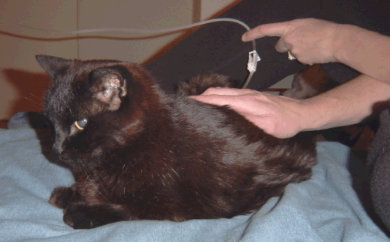
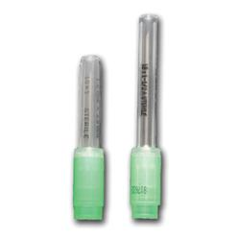
SUBCUTANEOUS ROUTE:
Dorsal midline-dorsal flank
18 G
Absorption of SQ fluids will occur over 6 to 8 hours. If prompt
correction of severe deficits are required this route would
Not be recommended.

Slide 27
Subcutaneous fluids are contraindicated when:
Infected or devitalized skin
Hypothermia
The patient requires dextrose
Severely dehydrated

Slide 28
For subcutaneous administration of fluids, the fluids are preferred to be
Hypertonic
Isotonic
Hypotonic
Super hypertonic

Slide 29
Answer
Note: Don’t forget to warm fluids before administering; they are assimilated into the body better at body temperature.
B. Only isotonic solutions can be properly absorbed when given subcutaneously.

Slide 30
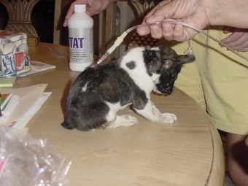
A PUPPY RECEIVING SQ FLUIDS AT HOME.

Slide 31
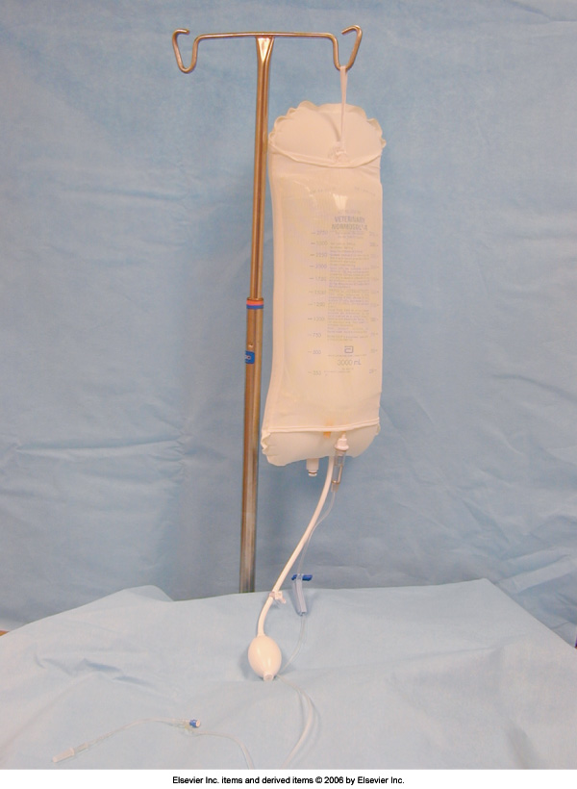
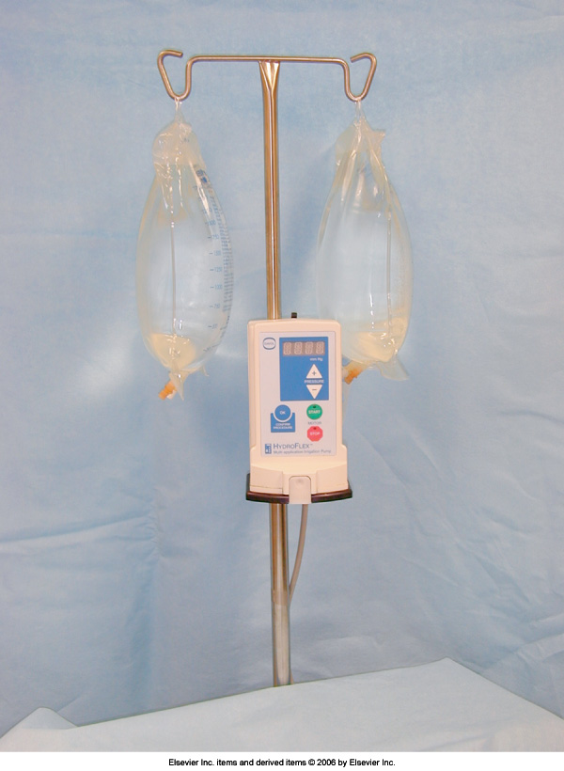
Pressurized Bag System
Automated Fluid Pump

Slide 32
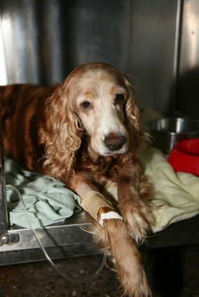
INTRAVENOUS ROUTE
HOW DOES THIS DOG LOOK TO YOU?

Slide 33
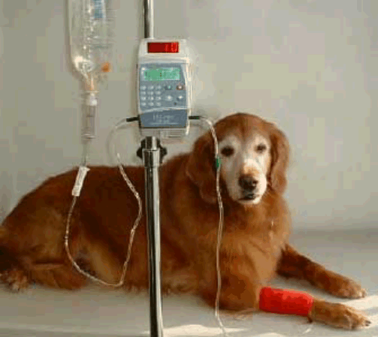
INTRAVENOUS ROUTE

Slide 34
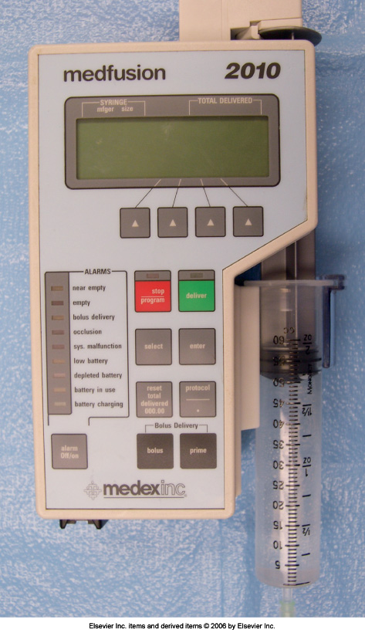
Medfusion 2010 Syringe Pump
This device is used for the administration of small volumes and slow rates of fluid (or drugs) to the cat and dog via a syringe and IV extension tubing line.

Slide 35
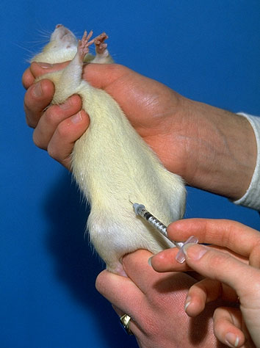
Intraperitoneal
Route
Not commonly used
In cats and dogs.
Very dangerous!

Slide 36
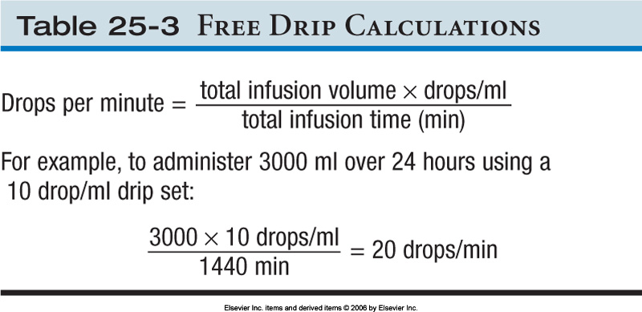
Total amt. needed
10/15/60 gtt/ml
24 hours
Turn to pg. 365 (VTDRG) for Calculating Drip Rates

Slide 37
Crystalloids –vs- Colloids
Crystalloids are aqueous solutions of mineral salts or other water-soluble molecules with variable electrolyte composition and contain no protein or colloids.
  Are in intravascular compartment for less than an hour
  Rapidly excreted in urine (if renal function is normal)
  Isotonic, hypertonic, or hypotonic
Colloids contain larger insoluble molecules, which act to retain existing fluid and promote movement of fluid into intravascular spaces
  Remain within the circulation.
In what circumstance would colloids benefit a patient
over crystalloids?

Slide 38
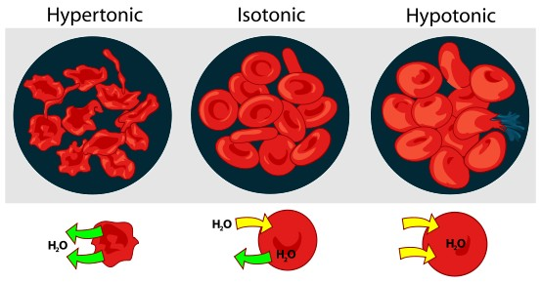
Types of Crystalloids

Slide 39
Isotonic Crystalloids
Most common type of fluids used to replace body fluids
Can be administered via any routes
Cells not affected by this type of solution
  Normal Saline (0.9% NaCl)
    Contraindicated with cardiac disease
  LRS
    Not suitable with transfusions (can cause clotting/agglutination)

Slide 40
Hypertonic Crystalloids
Greater osmotic pressure than blood – thereby encouraging movement of fluid from cells into circulation
Administered for shock, cerebral edema
Cannot be given SC
Contraindicated with renal/cardiac failure
  NaCl (3, 4, 5, 7, 23.4%)
Should be given in combination with a colloid or isotonic crystalloid.

Slide 41
Hypotonic Crystalloids
Lower osmotic pressure than blood – thereby encouraging movement of fluids into cells
Not to be used with shock/pulmonary or cerebral edema/
Examples:
  5% Dextrose in water (D5W)
  0.45% Saline
  2.5% Dextrose / 0.45% Saline

Slide 42
Types of IV Fluids Commonly Utilized
Please turn to page 363 in VTDRG
VTDRG pgs. 363-364

Slide 43
Various IV Fluids
Crystalloids
  LRS
  Normosol-R
  Plasma-Lyte A
  Ringers Solution
  Sodium Chloride 0.9%-Normal Saline
  Dextrose 5% in Water (D5W)
Colloids
  Whole blood
  Plasma
  Dextran 70*
  Hetastarch
  Oxyglobin
  *Dextran 70 is a synthetic colloid utilized as a plasma expander to treat shock from circulatory collapse.

Slide 44
General Rule of thumb
It is undesirable to mix multiple drugs in a syringe or intravenous fluids.
Sometimes drug interactions are visible, other times they are not.
Physical incompatibilities include precipitation and chemical inactivation.

Slide 45
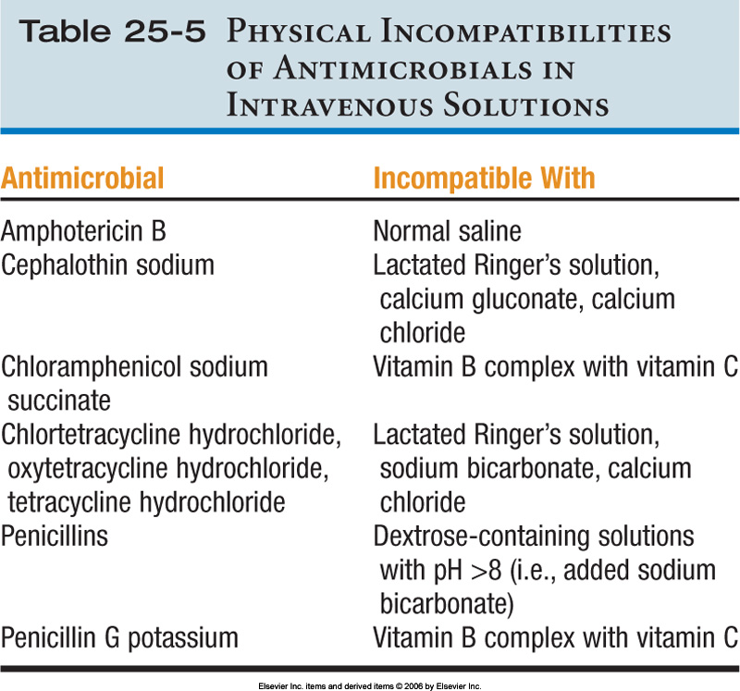

Slide 46
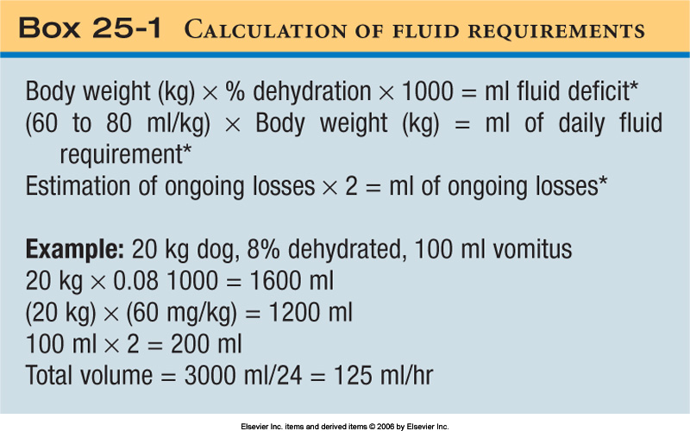
Calculation of Fluid Requirements
The volume of diarrhea and vomitus is frequently underestimated, so double the visually estimated amount to reflect the actual volume lost.
x
This is the fluid deficit.
ml
Daily fluid requirement-constant.
Multiply ongoing losses by 2 to get an estimate.
Add together for total volume to be replaced in milliliters over 24 hrs. Divide total volume by 24 hrs. to get hourly fluid rate needed for digital pump administration of continuous fluids. This is only for the first 24 hours.

Slide 47
Volume Overload or Hypervolemia!
Restlessness
Hyperpnea (abnormal increase in depth and rate of respiration but not to the point of labored)
Serous (watery) nasal discharge
Chemosis (edema of the ocular conjunctiva)
Pitting edema (remaining indented for a few minutes after removal of firm-finger-pressure. Over saturation of the cells.)
This is a condition in which there is too much fluid in the blood.

Slide 48
Causes of Volume Overload
Excessive total volume
Excessive rate of fluid administration
Decreased cardiac function
An animal with which condition is more
prone to fluid overload?
Early renal disease
Parvovirus infection
Cardiac insufficiency
Very thirsty

Slide 49
Answer
C. Cardiac insufficiencies.
Cardiac function is already impaired without adding extra fluid
Fluid overload increases the volume and workload on the heart.

Slide 50
If Volume Overload is Suspected
Auscultate the lungs for pulmonary edema – crackles can be heard
Obtain central venous pressures (pgs. 791-793)
Weight gain may be seen (Animals on a constant infusion of IV fluids should be weighed 3 times a day)
Turn to pg. 366-367 in VTDRG

Slide 51
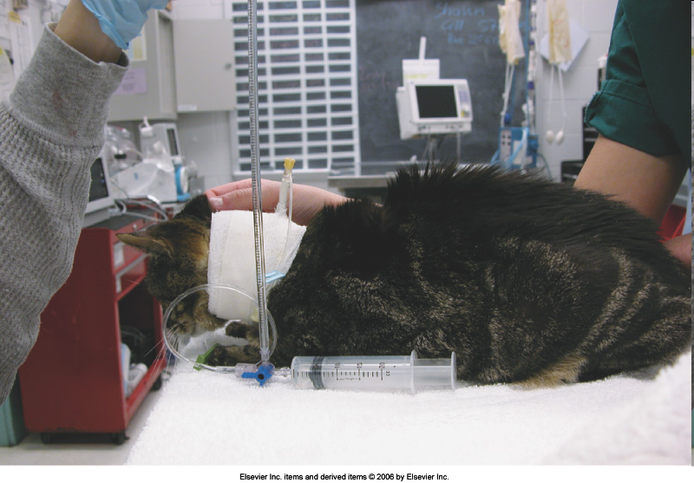
Use of a manometer to measure central venous pressure in a cat.
Also refer to VTDRG pgs. 334-335

Slide 52
Central Venous Pressure
Central venous pressure is the most direct way of accessing blood pressure but its invasiveness limits its use in routine procedures.
An intravenous catheter is placed in the cranial vena cava via the external jugular vein and a 3-way stopcock is attached.
IV fluids are attached to stopcock and a manometer is used to measure the pressure in the catheter.
Patient must be in lateral recumbency and the zero point of the manometer is positioned at the level of the sternum.
Three readings are taken and averaged to determine the CVP.
Normal canine CVP ranges between 0 – 5 cm of H₂O.
If pressure is consistently increased, fluid overload is suspected.

Slide 53
Fluid Administration Rate Guidelines
Maintenance Fluids:
  1ml/#/hr. for large dogs
  2ml/#/hr. for small dogs and cats
Anesthesia:
  5ml/#/hr.
Shock Fluids:
  40ml/#/hr. for dogs
  25ml/#/hr. for cats

Slide 54
Rapid Rehydration
Dog: 20ml/# for the 1st hour. Then give the maintenance rate.
Cat: 10ml/# for the 1st hour. Then start the maintenance rate.
Rapid rehydration is used for dehydrated animals (6-7% dehydration) and is a slower pace than the shock rate used for critical patients.

Slide 55
RVT’s Role in
Fluid Therapy Maintenance
Be familiar with the various types of IV fluids
Know how to calculate fluid administration
Be able to recognize signs of potential fluid overload
Measure and monitor a patient’s urinary output and diarrhea output
Know how to properly place catheters
Be familiar with IV pumps and drip sets
Ask questions!

Slide 56
The technician’s role in clinically assessing the patient is important in making appropriate adjustments in the administration of fluids.

